Slide 1

Business Opportunity London
Sonali Shah

Slide 2
Overview
Introduction
Data Description and Methodology
Results
Recommendations
Further work

Slide 3
Introduction
London: Vibrant, diverse and full of business opportunities. Consists of 32 boroughs and also the City of London, allowing for an opportunity to see investment flourish and business thrive
Scouting for business opportunities using business category popularity as the basis for investment pitch.

Slide 4
Data Description and Methodology
Data Extraction and cleaning
1
2
Data Analysis

Slide 5
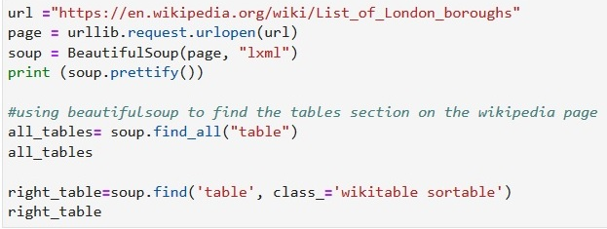
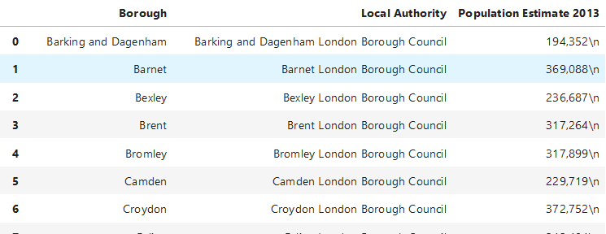
Data Extraction and Cleaning
Web-scraping

Slide 6
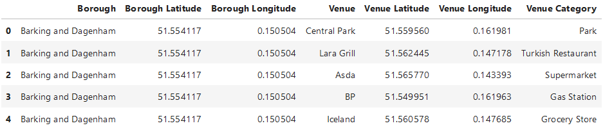
Data Extraction and Cleaning
Foursquare API to explore Boroughs

Slide 7
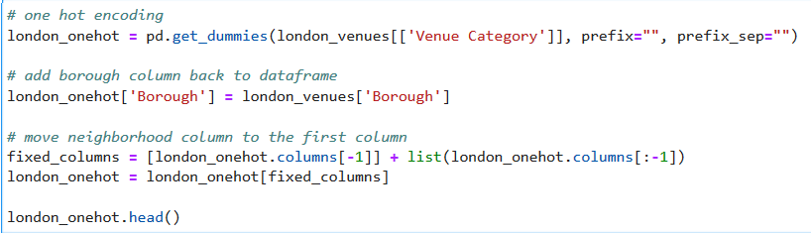
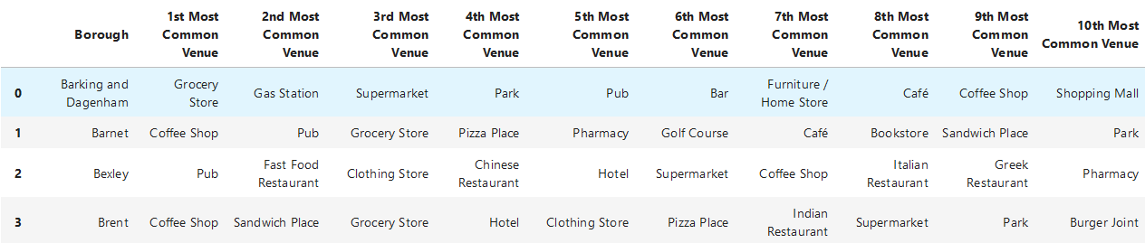
Data Analysis
Analyse each borough

Slide 8
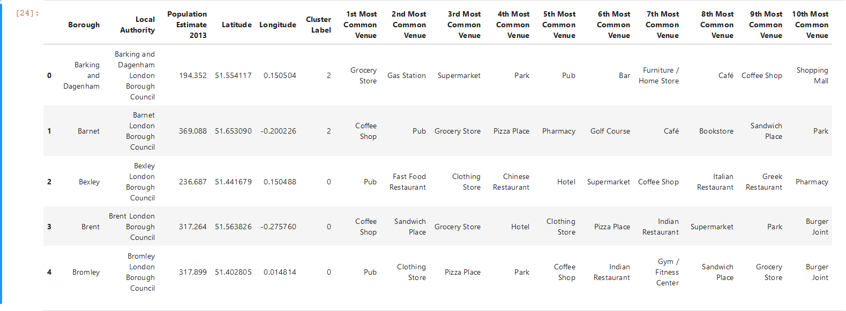
Data Analysis
Group cluster using top 10 most popular venue
K-means cluster analysis

Slide 9
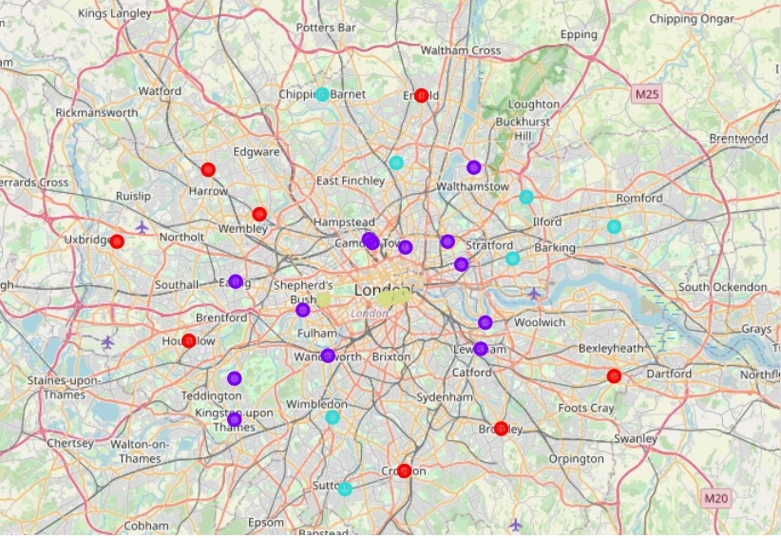
Results
Red: Pubs and coffee shops, Indian restaurants
Purple : Most common venue is pubs,followed by coffee shops
Blue: Grocery stores and Pubs, fast food and Italian restaurant in 2nd and 3rd most common venues for some boroughs
Yellow: Hotels
https://github.com/shahs1005/Battle-of-the-Neighbourhoods/blob/master/Capstone(1).ipynb

Slide 10
Recommendations
1
Coffee Shops
Red and Purple cluster.
1st and 2nd most popular venue
2
Restaurants
Indian Restaurant
most popular in Hounslow
2nd most popular in Harrow

Slide 11
Further Work
Explore coffee shop density in red and purple boroughs
Socioeconomic demographics
Ethnic mix in boroughs to understand popularity of Indian Restaurants

Slide 12
Thank you

